Slide 1
Machine Learning and having it deep and structured
Introduction

Slide 2
Outline
What is Machine Learning?
Deep Learning
Structured Learning

Slide 3
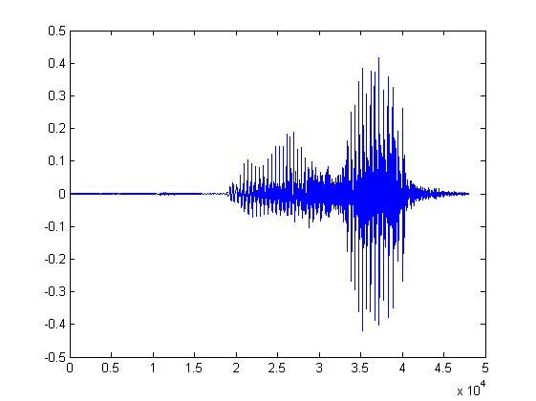
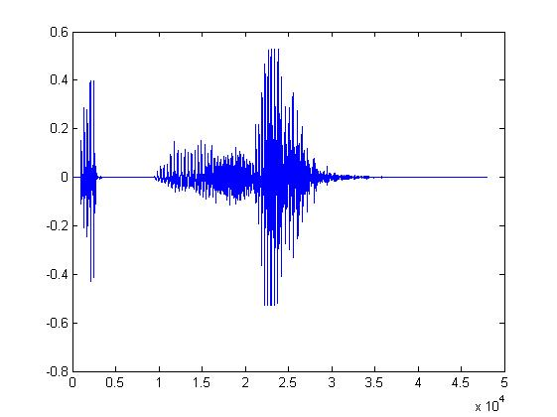
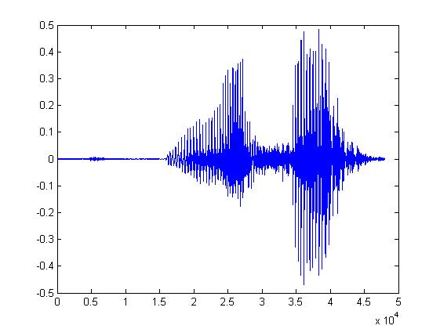
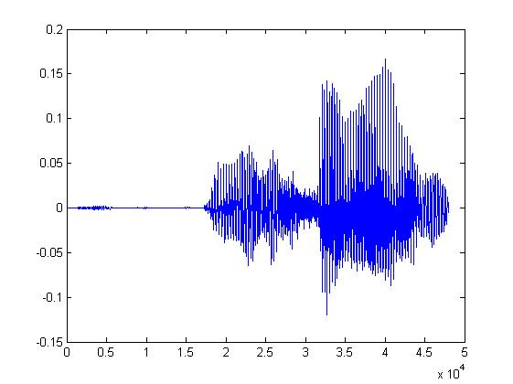
Some tasks are very complex
You know how to write programs.
One day, you are asked to write a program for speech recognition.
Find the common patterns from the left waveforms
你好
你好
You quickly get lost in the exceptions and special cases.
It seems impossible to write a program for speech recognition
你好
你好
Notes:
When you try to make such rules precise, It seems hopeless.

Slide 4


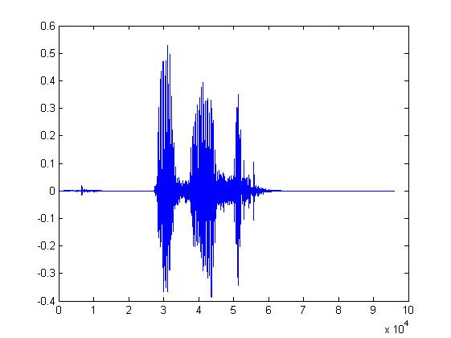
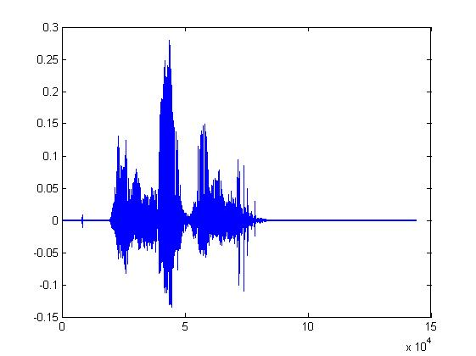
Let the machine learn by itself
你好
Learn how to do speech recognition
大家好
You said “你好”
人帥真好
You only have to write the program for learning
A large amount of audio data

Slide 5

Learning ≈ Looking for a Function
Speech Recognition
Handwritten Recognition
Weather forecast
Play video games
“你好”
“2”
weather today
“sunny tomorrow”
Positions and number of enemies
“jump”

Slide 6
Types of Learning
Supervised Learning
Reinforcement Learning
Unsupervised Learning

Slide 7

Supervised Learning
“你好”
“2”
(label)
Model
Hypothesis Function Set
大家好
“Best” Function
Training:
Pick the best Function f*
Testing:
Training
Data
x: function input
y: function output

Slide 8


Reinforcement Learning
Hypothesis Function Set
Example:
Dialogue System
Model
Bad!
How are you?
Good
Bye
x:
Training
Data
know how good f(x) is
No labels
f₁(x)=“Good Bye”

Slide 9

Reinforcement Learning
Hypothesis Function Set
Example:
Dialogue System
Model
Good!
Training:
Pick the best Function f*
How are you?
Fine.
Training
Data
know how good f(x) is
No labels
f₂(x)=“Fine”
Notes:
Play video games
“Good” is not “Correct”

Slide 10

Reinforcement Learning
Model
Hypothesis Function Set
Machine:
y’ = “hi”
“Best” Function
Training:
Pick the best Function f*
Testing:
Training
Data
know how good f(x) is
: x’ = “hello”
No labels

Slide 11

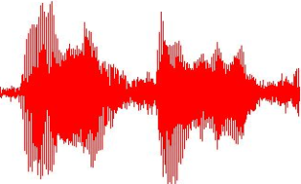
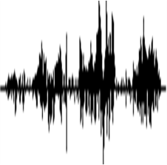
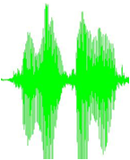
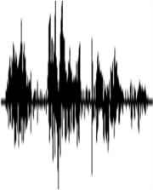

Unsupervised Learning
Training
Data
No labels
What can I do with these data?
Lots of audio
without text annotation

Slide 12
Outline
What is Machine Learning?
Deep Learning
Structured Learning

Slide 13
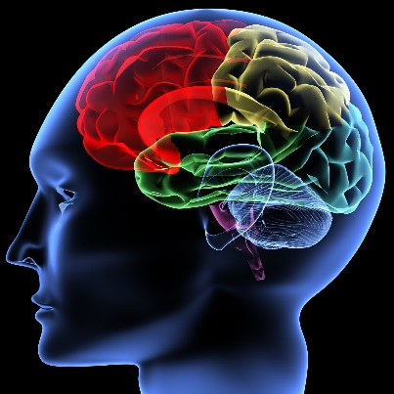
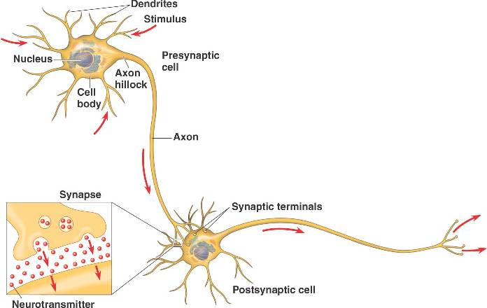
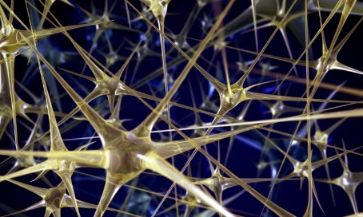
Inspired from human brain

Slide 14
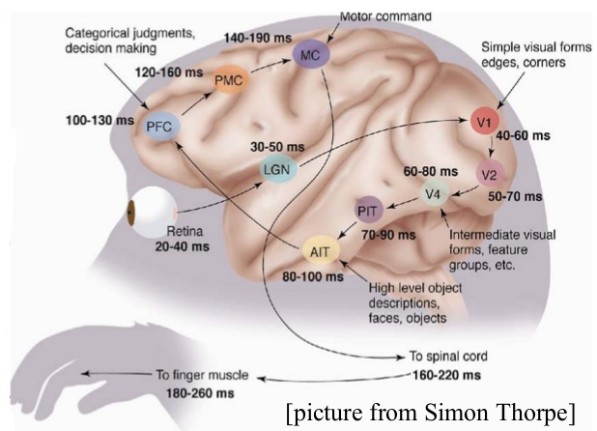
Human Brains are Deep
Notes:
In the Google/Stanford paper from 2012 "Building High-level Features Using Large Scale Unsupervised Learning" - they achieved a 70% improvement in cat-detection technology :)
http://static.googleusercontent.com/media/research.google.com/zh-TW//archive/unsupervised_icml2012.pdf
Google cats:
https://www.youtube.com/watch?v=-rIb_Meiylw
http://www.nytimes.com/video/technology/personaltech/100000003519478/appsmart-modernize-your-meetings.html?playlistId=1194811622271
METAPHYSICAL - In looking at some of the research papers, and seeing the "Master Neuron" images of Cats and Faces - that wasn't any one cat or one face - I was struck by the parallels to Plato's Theory of Forms (Platonic realism is a philosophical term usually used to refer to the idea of realism regarding the existence of universals or abstract objects).

Slide 15
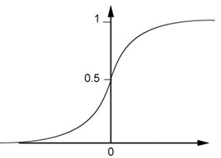
A Neuron for Machine
Each neuron is a function
Activation function
…
Sigmoid function
bias

Slide 16
Deep Learning
Neural Network: Cascading the neurons
Input
Layer 1
Layer 2
Layer L
Output
……
……
……
……
……
……
……
Hidden Layer
Notes:
Deep learning refers to deep neuron networks
For each neuron, the input can be input or hidden
Send information to next hidden or output
Given the input, how to compute the output

Slide 17
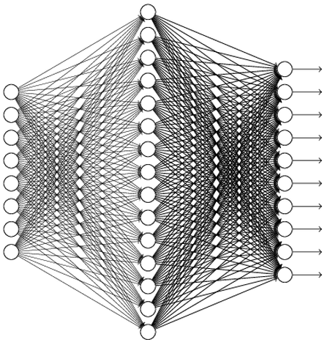
Deep Learning
Universality Theorem:
Any continuous function f
Can be realized by a network with one hidden layer
(given enough hidden neurons)
Reference: http://neuralnetworksanddeeplearning.com/chap4.html
Notes:
I am not very surprised.
Give me enough neuron I can……
Deep structure can realize the same function in a simpler way (less neurons, less parameters) than shallow structure.

Slide 18
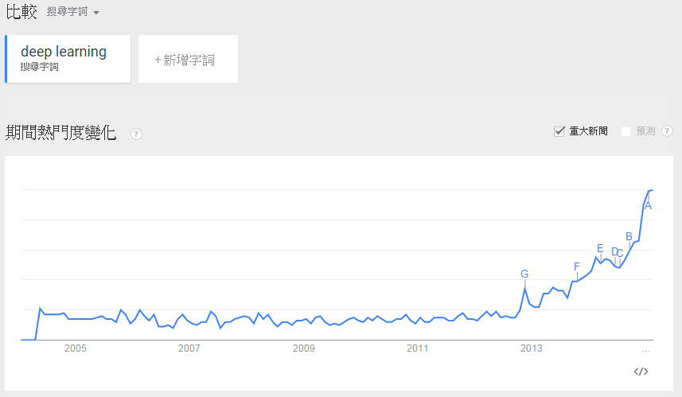
Popular
Notes:
2006 -> Initialization
2009 -> GPU
2011 -> Speech recognition
2012 -> Google Brain -> New York Time
image competition

Slide 19
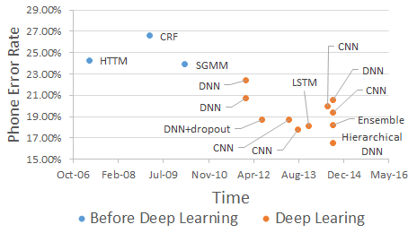
Powerful
Speech Recognition (TIMIT):
(Deep neural network on TIMIT usually used 4 to 8 layers)
Notes:
HW1 + HW2

Slide 20
Three misunderstandings about Deep Learning
1. Deep learning works because the model is more “complex”

Slide 21
Deep is simply more complex …..
Deep works better simply because it uses more parameters.
……
……
……
……
……
Shallow
Deep

Slide 22
Fat + Short v.s. Thin + Tall
Which one is better?
……
……
……
Shallow
Deep
Notes:
If a function can be realized by deep structure, using a shallower structure would be more difficult
That is, more neurons and thus more parameters.
To realize the same function
The neural network with deep structure is simpler
Since the model is simpler, less training data is needed.

Slide 23
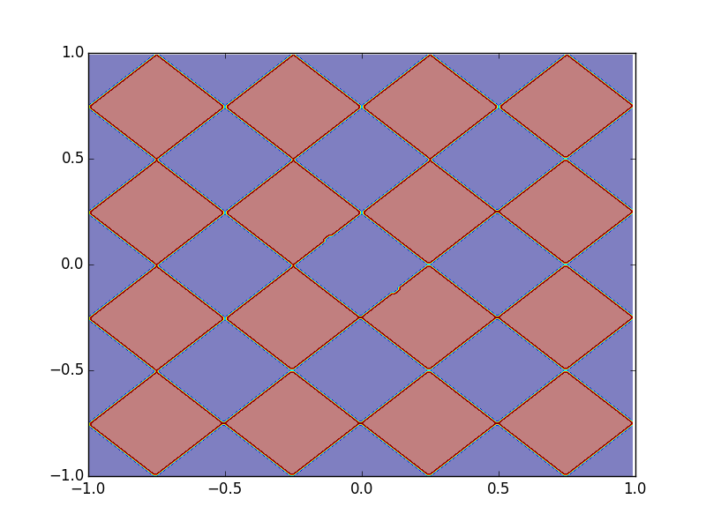
Deep Learning - Why? Toy Example
Sample 10,0000 points as training data
1
0
……
0 or 1
……
……
……
……
……

Slide 24
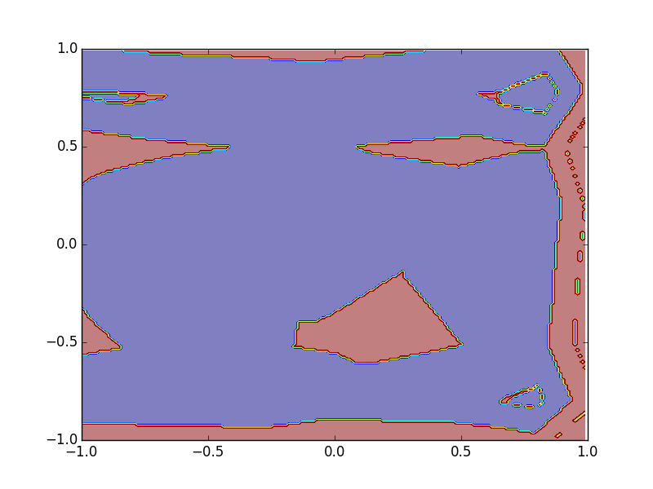
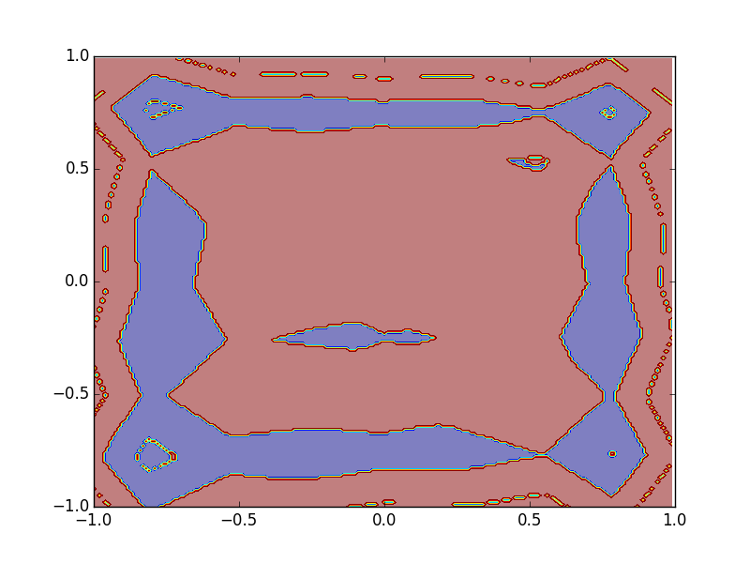
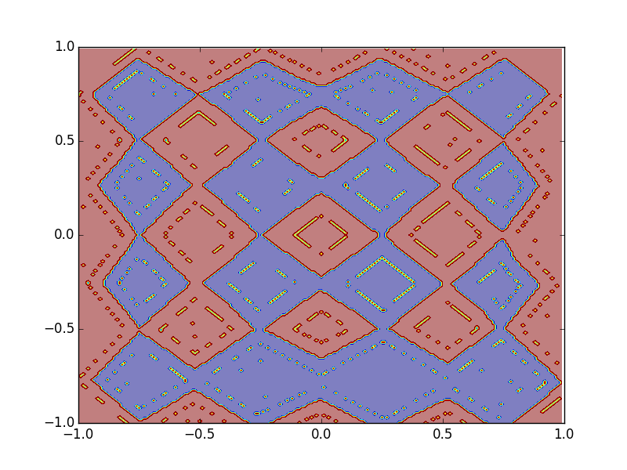
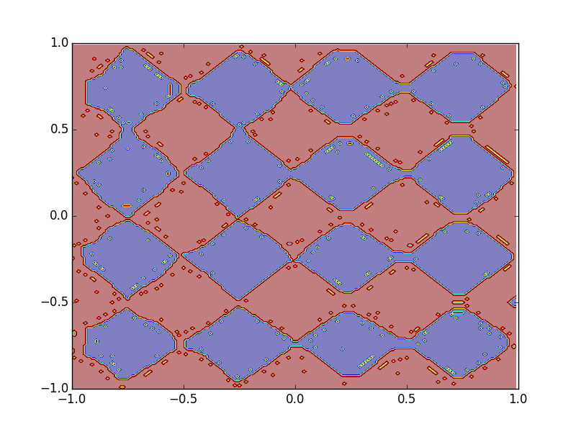
Deep Learning - Why? Toy Example
1 hidden layer:
125 neurons
500 neurons
2500 neurons
3 hidden layers:
How many neurons in each hidden layers?
100~200
25~50
50~100
Less than 25

Slide 25
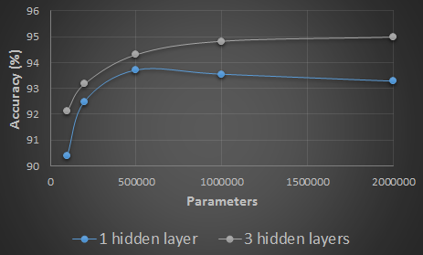
Deep Learning - Why?
Experiments on Hand-writing digit classification
Deeper: Using less parameters to achieve the same performance

Slide 26
Three misunderstandings about Deep Learning
2. When you are using deep learning, you need more training data.

Slide 27
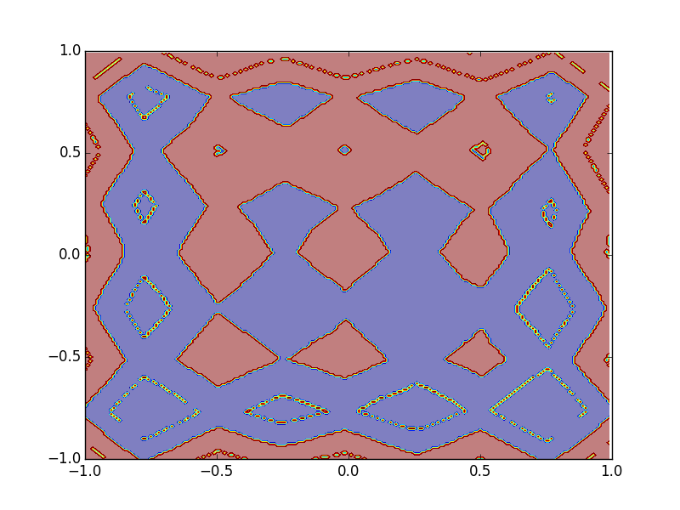
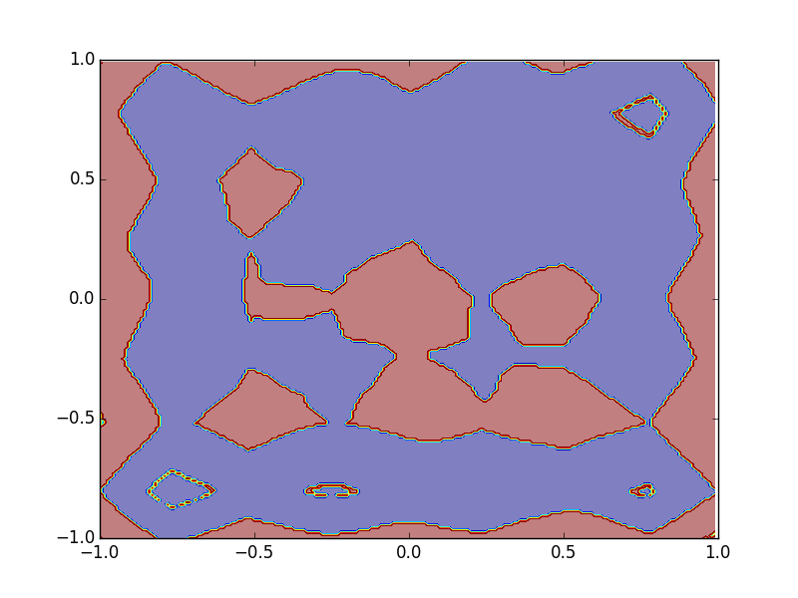
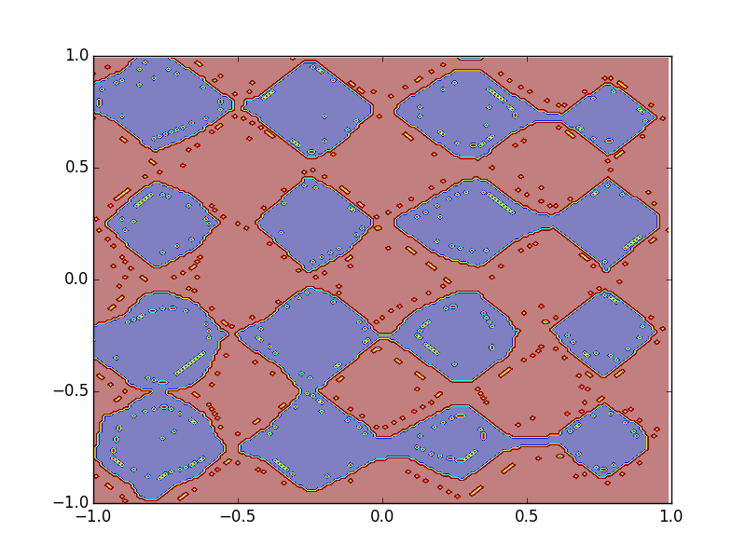
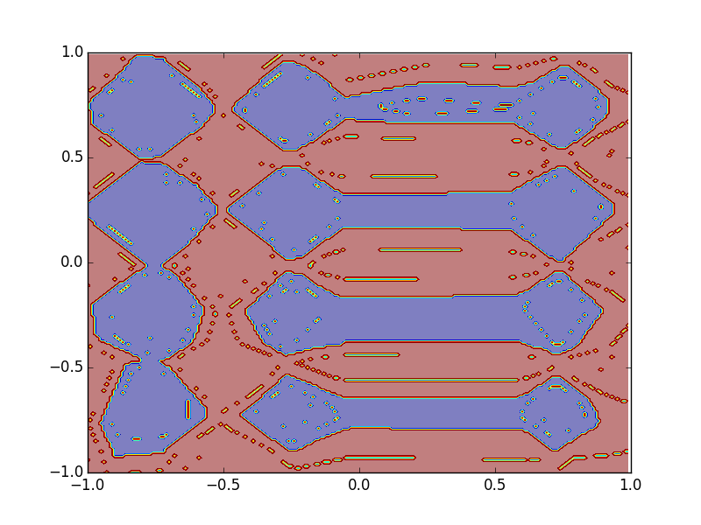
Size of Training Data
Different number of training examples
10,0000
5,0000
2,0000
1 hidden
layer
3 hidden
layers

Slide 28
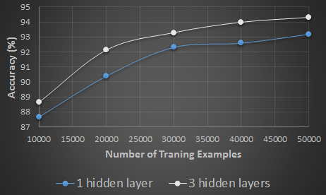
Size of Training Data
Experiments on Hand-writing digit classification
Deeper: Using less training data to achieve the same performance

Slide 29
Three misunderstandings about Deep Learning
3. You can simply get the power of deep by cascading the neurons.

Slide 30
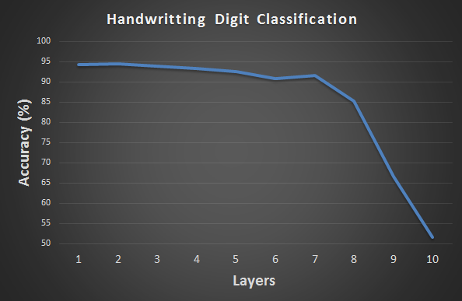
Hard to get the power of Deep …
Can I get all the power of deep from this course?
No, the researchers still do not understand all the mystery of deep learning.

Slide 31
Outline
What is Machine Learning?
Deep Learning
Structured Learning

Slide 32
In the real world ……
X (Input domain):
Sequence, graph structure, tree structure ……
Y (Output domain):
Sequence, graph structure, tree structure ……
Notes:
Just name a few
Take human language processing and image processing as examples

Slide 33

Retrieval
“Machine learning”
(keyword)
A list of web pages (Search Result)

Slide 34
Translation
“Machine learning and having it deep and structured”
“機器學習及其深層與結構化”
(One kind of sequence)
(Another kind of sequence)

Slide 35
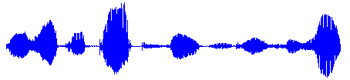
Speech Recognition
“大家好，歡迎大家來修機器學習及其深層與結構化”
(One kind of sequence)
(Another kind of sequence)
Notes:
HMM

Slide 36
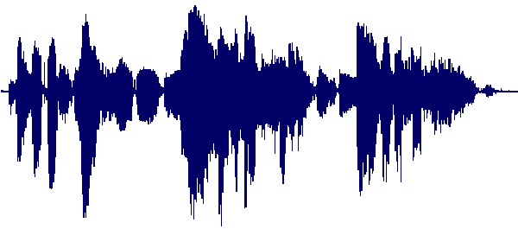
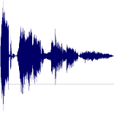
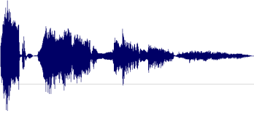
Speech Summarization
Record Lectures
Select the most informative segments to form a compact version
Summary
Notes:
Learning to rank

Slide 37

Object Detection
Image
Object Positions
Haruhi
Mikuru
Notes:
Image Segmentation

Slide 38
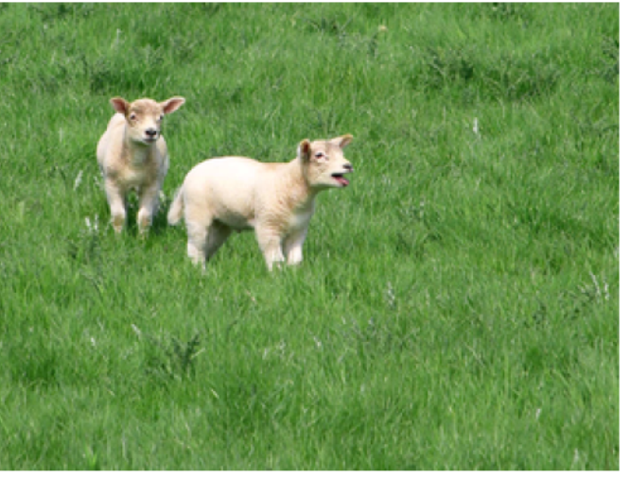
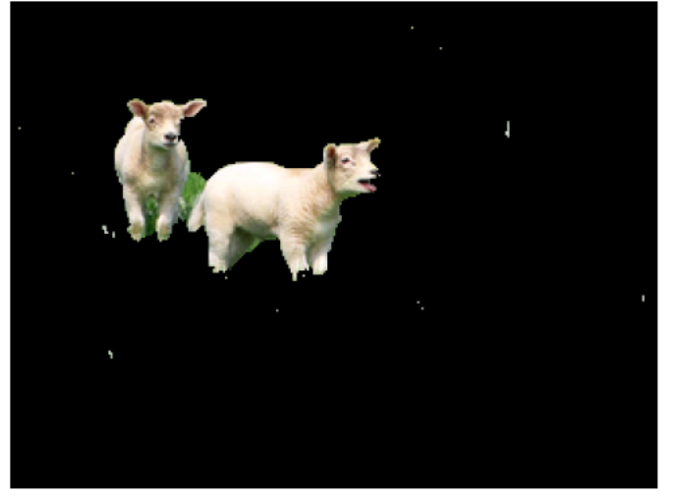
Image Segmentation
Image
foreground
Source of images: Nowozin, Sebastian, and Christoph H. Lampert. "Structured learning and prediction in computer vision." Foundations and Trends® in Computer Graphics and Vision 6.3–4 (2011): P57.
Notes:
http://msr-waypoint.com/en-us/um/people/pkohli/papers/skh_eccv08.pdf

Slide 39
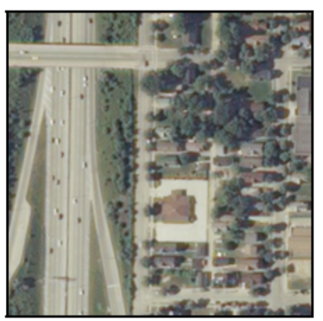
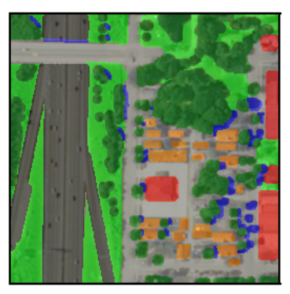
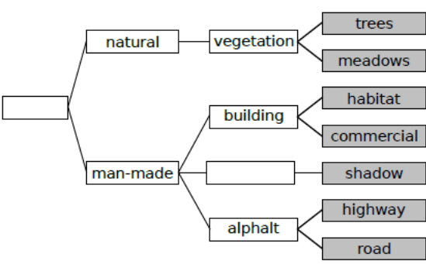
Remote Image Ground Survey
Source of images: Nowozin, Sebastian, and Christoph H. Lampert. "Structured learning and prediction in computer vision." Foundations and Trends® in Computer Graphics and Vision 6.3–4 (2011): P146.

Slide 40
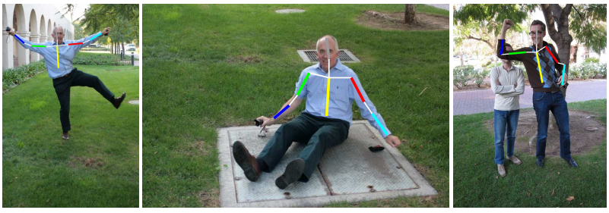
Pose Estimation
Image
Pose
Source of images: http://groups.inf.ed.ac.uk/calvin/Publications/eichner-techreport10.pdf
Notes:
Application?

Slide 41
Structured Learning
The tasks above are developed separately in the past.
Recently, people realize that there is a unified framework behind these approaches.
Three steps
Evaluation
Inference
Learning
Notes:
Hopefully, use new view to understand these approaches

Slide 42
Concluding Remarks
What is Machine Learning?
Deep Learning
Structured Learning

Slide 43
Reference
Deep Learning
Neural Networks and Deep Learning
http://neuralnetworksanddeeplearning.com/
For more information
http://deeplearning.net/
Structure Learning
Structured Learning and Prediction in Computer Vision.
http://www.nowozin.net/sebastian/papers/nowozin2011structured-tutorial.pdf
Linguistic Structure Prediction
http://www.cs.cmu.edu/afs/cs/Web/People/nasmith/LSP/PUBLISHED-frontmatter.pdf

Slide 44
Thank you!

Slide 45


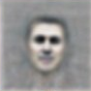
Powerful
Inspired from human brain
visual cortex
Retina
Layer 1
Layer 2
Layer L
……
……
……
……
……
……
……
……
……
……
Pixels
Edges
Primitive
Shapes
……
Notes:
http://techtalks.tv/talks/machine-learning-and-ai-via-brain-simulations/57862/
http://blog.csdn.net/visionhack/article/details/10229657
In each hemisphere of our brain, humans have a primary visual cortex, also known as V1, containing 140 million neurons, with tens of billions of connections between them. And yet human vision involves not just V1, but an entire series of visual cortices - V2, V3, V4, and V5 - doing progressively more complex image processing. We carry in our heads a supercomputer, tuned by evolution over hundreds of millions of years, and superbly adapted to understand the visual world. Recognizing handwritten digits isn't easy. Rather, we humans are stupendously, astoundingly good at making sense of what our eyes show us. But nearly all that work is done unconsciously. And so we don't usually appreciate how tough a problem our visual systems solve.

Slide 46
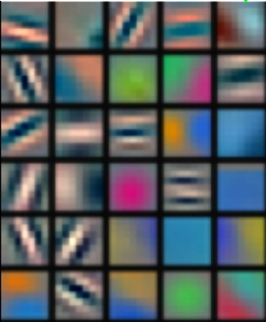
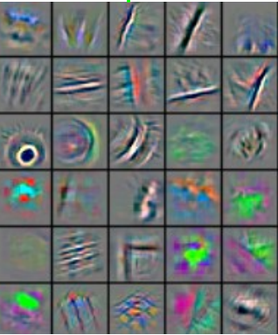
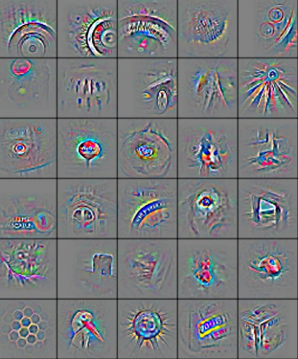
Powerful
Image Recognition
1st hidden layer
2nd hidden layer
3rd hidden layer
Reference: Zeiler, M. D., & Fergus, R. (2014). Visualizing and understanding convolutional networks. In Computer Vision–ECCV 2014 (pp. 818-833)
Notes:
http://arxiv.org/pdf/1311.2901v3.pdf

